Slide 1
Art
Observational drawing
Year 9
Term 1
1 – Observational drawing | 2 – Colour vocabulary
 | primary colours – The primary colours are red, yellow and blue. They cannot be made, but are used to make all other colours.
observational drawing: drawing what you see in front of you as realistically as possible. Tips for observational drawing:
Keep you pencil sharp
Look at the object / person you are drawing
Start drawing light lines: they are easier to rub out
Look at object / person you are drawing (again)
Draw rough shapes first and make sure you have the proportions right before you add detail
Look at what you are drawing (again)
secondary colours - Secondary colours are made by mixing 2 primary colours.
tertiary colours: made by mixing a primary and secondary colour together.
contrasting colours are opposite sides on the colour wheel.
harmonious colours and next to each other on the colour wheel.
3 – Pencil techniques | 4 - Definitions | 4 – Ben Rothery
hatching: lines are drawn in one direction. cross hatching: lines are drawn in two or more directions. stippling: Dots which are close together or far apart. overlay: Layering multiple colours | symmetry: when something is made up of identical parts facing each other. proportions: the size relationships between different parts. For instance the height compared to the width. pattern: a design that is created by repeating a shape. It can be a design on a fabric or a natural pattern, such as the markings on an animal’s fur. | Ben is a detail-obsessed illustrator who lives in London. He creates intricate and delicate illustrations inspired by his love of nature. He is best known for his beautiful illustrations of animals and insects.
Notes:
https://www.bbc.co.uk/bitesize/guides/z9y64j6/revision/2

Slide 2
CS
Cyber Security
Year 9
Term 1
Lesson 1
Lesson 2
Cyber security - to protect systems, networks, programs, devices and data from cyber attacks.
Data – is facts and figures/information
Customer – a person who buys goods or services.
Privacy policy - The types of information collected by the website or app
Data theft - is the act of stealing information stored on corporate databases, devices, and servers
Why is customer data valuable to businesses - Data can be used to help build a profile of the customer and therefore convert the data into information.
Internet bots - are automated programs that perform tasks repeatedly.
Social engineering - is a set of methods used by cybercriminals to deceive individuals into handing over information that they can use for fraudulent purposes.
Shouldering - (also known as shoulder surfing) is an attack designed to steal a victim's password or other sensitive data.
Name generator attacks - These are attacks in which the victim is asked in an app or a social media post to combine a few pieces of information or complete a short quiz to produce a name
Phishing - A phishing attack is an attack in which the victim receives an email disguised to look as if it has come from a reputable source, in order to trick them into giving up valuable data.
Blagging - (also known as pretexting) is an attack in which the perpetrator invents a scenario in order to convince the victim to give them data or money.
Lesson 3
Lesson 4
Hacking - Gaining unauthorised access to or control of a computer system
Ethical hacking - is the exploitation of an IT system with the permission of its owner to determine its vulnerabilities and weak points
Hacktivists are rarely motivated by theft, but are more interested in creating disruption to cause public embarrassment or to promote a cause.
Script kiddies - are hackers (not necessarily kids) who use tools downloaded from the internet that allow them to hack with little technical knowledge.
Denial of service attach (DoS) - This is a cyberattack in which the criminal makes a network resource unavailable to its intended users.
Distributed denial of service attack (DDoS) - This uses the same concept as a DoS attack, but this time it is multiple computers making the attacks at the same time
Malware - is software that is designed to gain access to your computer with malicious intent.
Viruses - are a malicious form of self-replicating software.
Worms - Worms replicate themselves but do not attach themselves to files as a virus does. Instead, worms spread through the network and use the system’s resources.
Ransomware - locks a computer, encrypts files, and therefore prevents the user from being able to access the data.
Trojan - is a piece of software that appears to perform a useful function (such as a game) but unbeknown to the user it also performs malicious actions.
Spyware - is unwanted software that monitors and gathers information on a person and how they use their computer.
Adware - . It infects a computer and causes it to download or display malicious adverts or pop-ups when the victim is online
.

Slide 3
CS
Cyber security
Year 9
Term 1
Lesson 5
Lesson 6
Worldwide spending on cybersecurity is forecasted to reach $133.7 billion in 2022
What could be put in place to make Networks even more secure?
Secure passwords (password managers)
A maximum number of attempts to log in before an account is locked
CAPTCHA
Biometrics
Two-factor authentication (2FA
Prevention strategies
Anti-malware
Firewall
Password rules
Auto-updates
Two-factor authentication
Biometrics
CAPTCHA
Staff training
68% of business leaders feel their cybersecurity risks are increasing
2% of breaches featured hacking, 28% involved malware, and 32–33% included social engineering
Firewall - A firewall checks incoming and outgoing network traffic. It scans the data to make sure it doesn’t contain anything malicious and that it follows the rules set by the network.
Anti-malware - Anti-malware is software that scans any file that is able to execute code. The anti-malware will have a list of definitions of sequences of code that they are aware are malicious. If the code in your files matches the definitions, the files are quarantined
Auto-updates - Auto-updates refers to software that automatically checks for available updates for the software you have on your computer
User authentication - verify the identify of someone who connects to a network resource.
User permissions
If individual accounts are compromised, the potential damage is limited
Users have less chance of introducing malware to the network if they can’t install software
There is less chance users will accidentally or deliberately tamper with data they shouldn’t be able to see
Check this website for live threats
around the world
threatmap.checkpoint.com

Slide 4
Drama
Pantomime
Year 7
Term 2
Drama | John Godber | Year 9 | Term 1
1 – Who is John Godber?
2 – The Playwright
John Godber is an English dramatist—primarily known for his observational comedies
Godber was born in 1956, in Upton, near Pontefract, West Yorkshire
He trained as a teacher of drama at Bretton Hall College
He became the artistic director of Hull Truck Theatre Company in 1984
A 1993 survey for Plays and Players magazine cited Godber as the third most performed playwright in the UK, after Shakespeare and Alan Ayckbourn
His plays are performed all over the world
In 2011, Godber became creative director at Theatre Royal Wakefield and set up The John Godber Company as its resident company.
Playwrights, often known as writers, dramatists, or scriptwriters, write the story for the theatrical productions.
The story or script is written in a specific format. The playwright writes the dialogue of a character next to, or under, their name. They also include descriptions of settings, and stage directions for the actors and actresses to take to production.
Playwrights have an extremely difficult job. They must not only write a good script but also must find a producer willing to finance the production. In some instances, a producer may have an idea that they want developed, and will hire a playwright to write a suitable script.
3 - Theatrical Skills
4 – Godber’s Style
Key Vocabulary
direct address: when a character speaks directly to the audience
stereotype: a fixed general image or set of characteristics
improvisation: a piece of drama that is made up on the spot by performers without using any prepared material
flashback: a scene which shows events from before the main action of the play
mime: the use of movements, gestures and facial expressions to communicate an idea without words
marking the moment: a technique that draws the audience’s attention to an important moment
Key Vocabulary
fast pace: moving or developing very quickly
slick: something done in a smooth and efficient way
comedy: a play characterised by its humorous or satirical tone and its depiction of amusing people or incidents
synchronised: to cause two or more things to happen at the same time and speed as each other
movement: where (and how) an actor moves on stage, what this communicates to the audience, and the effect this has upon the drama
Notes:
https://www.bbc.co.uk/bitesize/guides/z9y64j6/revision/2

Slide 5
English
‘Of Mice and Men’ – John Steinbeck
Year 9
Term 1
1 – Methods
 | 2 – Vocabulary | 3 – Context: The Great Depression
 | illustrates (verb): to make something clear or visible e.g. The novella illustrates a patriarchal society. depicts (verb): to portray in words; describe e.g. Steinbeck depicts Slim as extremely powerful when he uses the simile ‘God - like’. educates (verb): to develop the mental, moral or social understanding of someone e.g. e.g. Steinbeck educates us about the impact of racial discrimination in the 1930s. alludes (verb): to hint at something indirectly e.g. Curley’s wife’s mannerisms allude to her loneliness. | ‘Of Mice and Men’ is set in Salinas, California – where John Steinbeck was born. The novella is set in the 1930s during the time of the Great Depression. The Great Depression started in 1929 when the Wall Street Crash meant the USA’s economy was destroyed. Unemployment during the Great Depression rose to 25%. Many people had very little money. Lots of farmers and ranch (farm) workers often moved from one place to another to try find jobs.
foreshadowing: clues or hints towards something that will happen later on in the story
cyclical structure: when the conditions at the end of a story are in some way the same as the start
simile: comparison of one thing to another, using ‘like’ or ‘as’
colloquialisms: words or phrases that are informal/ slang
vulgarisms: a word or expression that is offensive such as swearing
4 - Context 2: Oppression in the 1930s | 5 - Grammar: Speech Marks | 6 – Themes
.Race and Segregation Racial discrimination was not illegal in 1930s America. White and black people were segregated (separated) and black people were considered as second class citizens, e.g. they were paid less Disability People with disabilities were prejudiced against. Age The elderly were vulnerable during the Great Depression as they lost savings or could not find new work. Gender Women were not treated equally compared to men. There was a patriarchal society, where women were seen as inferior (not as strong/intelligent) as men. | Punctuation is used in direct speech to separate spoken words, or dialogue, from the rest of a story. The words spoken by a character sit inside speech marks: e.g. “Did you hear that noise?” whispered George. A new speaker in conversation needs a new line. Each new line of direct speech should also start with a capital letter: “I think there is something moving in the bushes,” George said. “I can’t see anything,” said Lennie. Each section of direct speech should end with a punctuation mark, e.g. full stop, question mark or exclamation mark: “Listen! I definitely heard something that time!” whispered George. | theme: a ‘big idea’ that runs throughout a whole text Friendships: Friendships in the story include George and Lennie, Crooks and Lennie, George and Slim. These friendships show how people benefit from companionship. The American Dream: ‘The American Dream’ is the idea of a happy way of living Many Americans think this can be achieved by working hard and then becoming successful ‘Of Mice and Men’ suggests how the American Dream does not always work out because of things like unemployment and oppression. Loneliness: There are lots of lonely characters in the story, such as Crooks and Curley’s Wife Steinbeck uses these characters to reflect on the discrimination people suffered from in the 1930s which led to loneliness.
Notes:
https://www.bbc.co.uk/bitesize/guides/z9y64j6/revision/2

Slide 6
French
Year 8
Term 4
French | Customs and Celebrations | Year 9 | Term 1
1 – Key Dates | 2 – Opinions and Reasons | 3 – Key vocabulary
j’adore
j’aime
je déteste
je n’aime pas
j’aime bien
je préfère
parce que c’est
car c’est
ma fête préférée, c’est…
my favourite celebration is…
à mon avis in my opinion
je pense que I think that
je crois que I believe that
selon moi according to me
le billet ticket
le défilé parade
le feu d’artifice firework
le jeu game
le jouet toy
le jour férié bank holiday
le repas meal
s’amuser to have fun
célébrer to celebrate
donner to give
fêter to celebrate
recevoir to receive
chercher to look for
se déguiser to dress up
dîner to dine
s’habiller to dress
ouvrir to open
se réveiller to wake up
chrétien/ne Christian
juif/juive Jewish
musulman/e Muslim
réligieux/euse religious
date | French name | English name
1 janvier | le Jour de l’An | New Year’s Day
6 janvier | la Fête des Rois | Epiphany
14 février | la Saint Valentin | Valentine’s Day
mars/avril | le Pâques | Easter
1 avril | le Poisson d’avril | April Fool’s day
1 mai | la Fête du Travail | May day
mai | Aïd el-Fitr | Eid al-Fitr
juin | la Fête des Mères | Mother’s Day
juillet | Aïd el-Kebir | Eid al-Adha
14 juillet | la Fête Nationale | Bastille Day
1 novembre | la Toussaint | All Saints’ Day
24 décembre | la Veille de Noël | Christmas Eve
25 décembre | le Noël | Christmas
31 décembre | la Saint-Sylvestre | New Year’s Eve
I love
I like
I hate
I don’t like
I quite like
I prefer
because it is
because it is
amusant/e fun
difficile difficult
divertissant/e entertaining
ennuyeux/euse boring
effrayant/e scary
émouvant/e moving
énervant/e annoying
fatigant/e tiring
génial/e great
idiot/e stupid
nul/le rubbish
passionnant/e exciting
très very
un peu a little
assez quite
le cadeau present
la fête celebration
la blague joke
l’église church
la dinde turkey
la messe Mass
la mosquée mosque
la réunion meeting
la veille day before
4 – Present Tense Verbs | 5 – Near Future Tense | 6 – Comparatives & Superlatives
To conjugate verbs in the present tense we remove the –infinitive ending and add the correct ending to match the person doing that action:
regarder → je regarde = I watch / I am watching
jouer → nous jouons = we play / we are playing finir → je finis = I finish / I am finishing attendre → j’attendez = I wait / I am waiting
aller (in the present tense) + infinitive verb
je vais fêter le Noël = I am going to celebrate Christmas nous allons s’amuser = we are going to have fun je ne vais pas lire un livre = I’m not going to read a book
You can use a range of other sentence starters to talk about the future. These need to be followed by an infinitive verb too.
j’espère ouvrir I hope to open j’ai l’intention de donner I intend to give je voudrais célébrer I would like to celebrate We use ce sera (it will be) to give opinions in the future.
Comparatives compare two things to each other.
In French you need to wrap your comparative around an adjective.
plus...que more … than
moins...que less … than
aussi...que as ... as
Pronoun | ER verb ending | IR verb ending | RE verb ending
je | e | is | s
tu | es | is | s
il/elle/on | e | it | -
nous | ons | issons | ons
vous | ez | issez | ez
ils/elles | ent | iissent | ent
Superlatives are used to say the most or the least with an adjective.
le/la/les plus … the most …
le/la/les moins … the least …
Irregulars:
meilleur/e que le/la meilleur/e better than the best
pire que - worse than le/la pire – the worst
Notes:
https://www.bbc.co.uk/bitesize/guides/z9y64j6/revision/2

Slide 7
Geography | Climate Change | Year 9 | Term 1
1 – Evidence of Climate Change | 2 – Causes of Climate Change | 3 – Impacts on the UK
Key Vocabulary:
climate : average weather conditions over the course of a year
Climate change has occurred for the past 800,000 years, where we have reliable data.
To see that climate change was a natural event we looked at CO2 , global temperature and sea levels.
However, to see current climate change we use satellite images, photos and atmospheric data.
Key Vocabulary:
human: is something caused by ourselves
natural: where we have no control over the cause
Climate change is a natural event which has been accelerated due to human activity.
Human causes of climate change include burning fossil fuels, deforestation, and farming.
Natural causes of climate change are due to changes in the Earth’s orbit of the Sun, solar activity and volcanic eruptions.
Key Vocabulary:
extreme weather: are events that are unusual due to their severity
The weather in 2020 was at record levels for rainfall in February and record dry days in April.
One of the major impacts of climate change is the melting of the polar ice caps at the poles.
Rising sea levels will claim areas of land such as fertile farmland and urban areas such as Liverpool. This is due to the UK being an island.
4 – Impacts on Asia | 5 – Impacts on Africa | 6 – What can you do?
 |  | Key Vocabulary: adapting: is making something suitable for a new use or purpose carbon footprint: is the amount of carbon used in everyday life To reduce our carbon footprint we need to walk, cycle and use public transport more. We need to eat food which is locally produced and reduce the amount of animal based products. We also need to use less electricity and recycle.
Key Vocabulary:
uninhabitable: is a place where humans cannot live
scarcity: is where there is a lack of a resource
Russia is impacted the melting of the permafrost.
The Himalayan Glaciers will melt which results in an increase in flooding.
In addition the glaciers are a water source for 1.9 billion people which is disappearing.
Food and water will become more scarce in the ME which will increase conflict between nations.
Key Vocabulary:
arid: is where water is a scarce
desertification: is the increased size of a desert
The Western Sahel Region of Africa is being swallowed up by the Sahara Desert due to a lack of rainfall and deforestation.
Farmland is lost by the desert growing and there are less opportunities for humans in the region.
86% of Burkina Faso’s GDP is at risk due to water scarcity and disappearance of farmland.

Slide 8
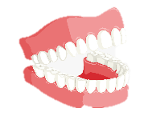
Literacy B | Spelling Rules - Plurals | KS3 | Term 1
Week 1 – need to know vocabulary! | Week 2 – Just add ‘s’! | Week 3 – Y and I
vowel: a, e, i, o,u consonant: any letter that isn’t a vowel plural: more than one singular: just one prefix: letters at the start of a word suffix: letters at the end of a word | attempts castles carriages If a word ends in a consonant or ‘e’, just add s to make the plural! stripes hedges birds | city cities When a word ends in ‘y’, change ‘y’ to ‘I’, then add –es! family families
- y +ies
- y +ies
Week 4 – a different word! | Week 5 – adding ‘es’ | Week 6 – f > v
Some plurals need completely different words! person people tooth teeth Some words stay the same! sheep sheep | watch watches If a word ends in –ch, -sh, -x or -s you need to add – es to the end dish dishes | thief thieves Some words ending in –f have the f changed to v then add –es, but some just add –s. roof roofs
+es
-f +ves
+es
+s
Notes:
https://www.bbc.co.uk/bitesize/guides/z9y64j6/revision/2

Slide 9
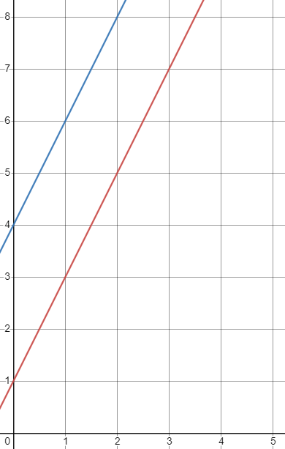
Mathematics
Place Value and Proportion
Year 7
Term 2
Mathematics | Reasoning with Proportion | Year 9 | Term 1
 | 2 – Equations and Inequalities 2 | 3 – Coordinates
 | formula: a mathematical rule expressed with symbols e.g. f = ma The plural of formula is formulae substitute: where we replace a letter with a number. evaluate: to calculate the value of. e.g. if y = 7 evaluate 5y . Answer 5 x 7 = 35
1 – Equations and Inequalities 1
equation: a statement that two things are equal, it contains expressions on both sides of the equal sign.
e.g. 5 = 2x + 1
solution: the answer when you solve an equation
Inverse: the opposite
symbols to remember:
( 3 , 5 )
x coordinate
y coordinate
This is a horizontal line
This is a vertical line
≠ not equal
< less than
> more than
≤ less than or equal to
≥ greater than or equal to
Origin— This is usually the point (0,0)
4 – Linear graphs | 5 – Types of Numbers | 6 – 7 Times Tables
 | factor: numbers which can be multiplied together to make another number. 3 and 2 are factors of 6 because 3 x 2 = 6 multiples: a number in the times table of another number 4, 8, 12, 16 and 20 are multiples of 4 prime numbers: have exactly 2 factors – itself and one 2 , 3 , 5 , 7 , 11 , 13 , 17 , 19 ….. even numbers – 2 , 4 , 6 , 8 , 10 , 12 …. odd numbers – 1 , 3 , 5 , 7 , 9 , 11 , 13 ….
y-intercept: Where a line crosses the y – axis
linear graph: produces a continuous straight line
1 x 7 = 7
2 x 7 = 14
3 x 7 = 21
4 x 7 = 28
5 x 7 = 35
6 x 7 = 42
7 x 7 = 49
8 x 7 = 56
9 x 7 = 63
10 x 7 = 70
11 x 17 = 77
12 x 7 = 84
non-linear graph: does not produce a continuous straight line
gradient: how steep a line is
parallel lines have the same gradient

Slide 10
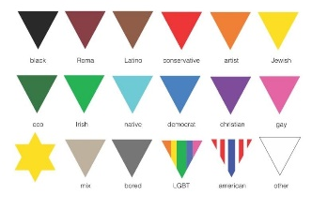
Modern History | Life in Nazi Germany | Year 9 | Term 1
1 – Women | 2 – Children | 3 – Germans
Aryan: a Germanic race the Nazis believed was superior to others
propaganda: methods to influence how someone thinks
eugenics: the study of reproduction
Not all Germans were Nazis. The Nazis tried to keep these people under control, using positive and negative methods.
From 1933 Hitler promised ‘bread and work’, and full employment. He used unemployed men between 18 and 25 years old to build the 1936 Berlin Olympic Stadium.
From 1935 onwards, men were conscripted into the army.
He wanted Germany to be self-sufficient – autarky.
The Nazis introduced a programme called ‘Strength Through Joy’ – this rewarded workers with theatre trips, picnics and holidays.
Hitler designed the Volkswagen (the people’s car) for German workers to buy (although car production stopped when the Second World War started in 1939).
During the 1920s, German women had enjoyed more liberal lives E.G. drinking and smoking.
In the 1930s, Nazism said that women should return to traditional roles. They encouraged the 3 Ks (Kinder (children), Kuche (kitchen), Kirche (church).
Women were expected to have several Aryan children.
Women were to wear plain clothing, wear no make-up and have their hair tied up.
In 1933, Hitler gave newlyweds 1,000 marks, allowing them to keep 250 marks for every child they had.
The Motherhood Cross was given to women who had children.
The Nazis believed children were important. He influenced them through: school, propaganda, and youth groups.
Textbooks, especially history and biology, were re-written to promote Germany, Aryans and anti-Semitism.
Eugenics was taught in all schools.
Boys mostly learnt history, eugenics and PE.
They attended the Hitler Youth where they were prepared for the army.
Girls mostly learnt housework, eugenics and PE.
They attended the League of German Maidens where they were prepared for motherhood.
4 – Terror Tactics | 5 – Religion in Germany | 6 – Undesirables
The Nazis also frightened people into supporting them.
The SS (Schutzstaffel) was Hitler’s private army. He used them as an execution squad on his opponents and as guards in concentration camps.
The Gestapo were the secret police. Over 150,000 people reported anti-Nazi behaviour to them.
The Gestapo did not wear uniform, so Germans didn’t know who / where the Gestapo were.
Their tactics included murder and torture.
Heinrich Himmler was the head of the SS and police.
‘People’s Courts’ charged the Nazi’s enemies with treason without a trial.
By the 1930s, there were 45 million Protestants and 22 million Catholics living in Germany – they were a threat to the Nazis.
The Nazis created a church called the Reich Church, to bring the different types of religion together.
The German Christians worked within the Reich Church.
Many religious people opposed the Nazis. Martin Niemoller set up the Confessional Church and was arrested and sent to a concentration camp in 1937.
800 Pastors of the Confessional Church were arrested and sent to camps.
In 1937, Pope Pius XI publicly criticised the Nazis and so 400 Catholic priests were sent to Dachau concentration camp.
The Nazis power over the Church did not last past the outbreak of the Second World War.
Hitler believed in the superiority of the Aryan Race.
The Nazis hated particular ‘undesirable’ groups such as: Jews, Gypsies, homosexuals, disabled people, Poles, and political opponents.
Many of these groups were sterilised to stop them having children.
Between 1939 and 1941 over 100,000 disabled Germans were killed in secret, without the consent of their families.
Millions were sent to concentration camps. 85% of Germany’s Gypsies died in camps.
These groups wore different coloured triangles to show other prisoners who they were.
Notes:
https://www.bbc.co.uk/bitesize/guides/z9y64j6/revision/2

Slide 11
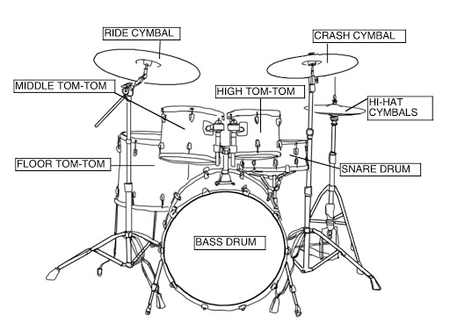
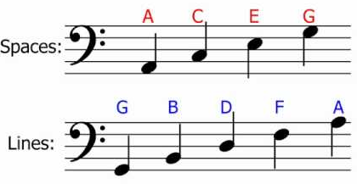
Music of the Sahara
Year 7
Term 2
Music | Musical Futures | Year 9 | Term 1
1 – The Evolution of Pop Music
2 – The Guitar
Key Vocabulary
blues: musical form which was originated in the Deep South of the United States around the 1860s by African-Americans.
jazz: music in which improvisation is typically an important part.
rock and roll: a type of popular dance music originating in the 1950s, characterised by a heavy beat and simple melodies.
pop: any commercially oriented music intended to be received and appreciated by a wide audience
Key Vocabulary
amplifier: an electronic devise with is used to allow an electric instrument to be heard.
3 – The Drum Kit
4 – The Bass Guitar
Key Vocabulary
bass clef: where the lower pitches are notated.

Slide 12
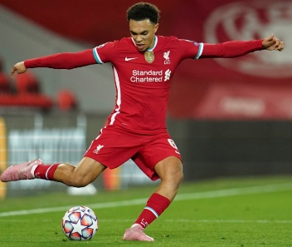
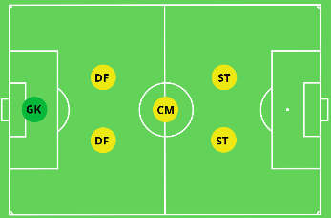
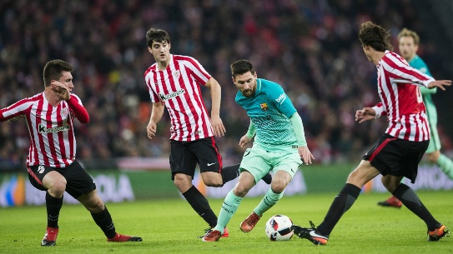
PE | Football | Year 9 | Term 1
1 – Dribbling | 2 – Passing | 3 – Receiving
 | Key Vocabulary drilled pass: passing the ball with power using the laces Technique for a drilled pass: | Key Vocabulary scan: looking behind and around for space and players moving screen: turning with the ball without touching it. Technique for moving screen:
Key Vocabulary
agility: the ability to change direction quickly
step-over: moving one foot over the ball without touching it then taking the ball in the opposite direction.
Technique for a step-over:
Non kicking foot by the side of the ball
Arms out for balance
Keep chest and head over the ball
Strike the ball with the laces
Shield the ball from the defender
Open the body up to be side on
Allow the ball to roll across the front of it
Accelerate away from defender
Roll one foot over the top of the ball
Feint body in the same direction
Push ball in the opposite direction
Accelerate away from defender
4 – Defending | 5 – Shooting | 6 – Positional play
Key Vocabulary overload: having more defenders than attackers in area. prevent: to stop the attacker from scoring a goal. | Key Vocabulary curl: curving the ball around an object. placement: the action of placing something somewhere specific. Technique to curl the ball: Place non kicking foot by the ball Make contact on the outside of the ball with the inside of the ball Aim to apply spin to the ball | Key Vocabulary formation: the arrangement of players on the pitch
In possession
Move up the pitch as a team
Make the pitch as big as possible
Support teammates who have the ball
Out of possession
Have all players between the ball and your goal
Make the pitch small (compact)

Slide 13
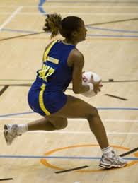
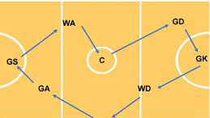
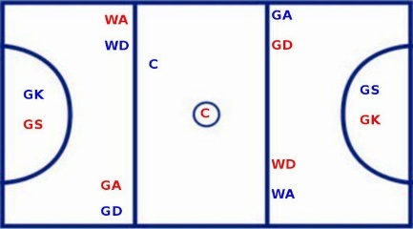
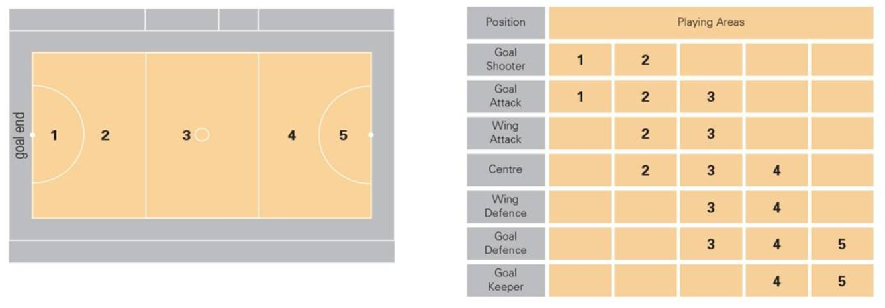
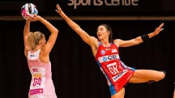
PE | Netball | Year 9 | Term 1
1 – Passing | 2 – Footwork | 3 – Attacking
 | Key Vocabulary running footwork: to receive the ball on the move landing 1, 2 then pass the ball before the third step. Teaching point for footwork: Turning in the air before landing is beneficial because it saves time so you don’t have to land and then pivot. | Key Vocabulary counter attacking: When the defending team win the ball unexpectedly and immediately attack, taking advantage of the fact that there will be gaps on the court court linkage: this is when you make the most of the space on the court and the position of team members by passing the ball down the court. For example, GK – GD – WD – C – WA – GA – GS.
Bounce pass teaching points:
bounce from chest height
ball should hit the floor two-thirds of the distance towards the receiver
Shoulder pass teaching points:
from head height,
opposite foot forward,
elbow in
Overhead pass teaching points:
above head, elbows in
spread fingers around the ball
used for longer distance.
4 – Defending | 5 – Shooting | 6 – Positional Play
Key Vocabulary blocking: to face your player front on, and use quick side steps to prevent them running past you Stages of defence: Stage 1: mark the player even when they do not have the ball. Stay close to your opposing player. Stage 2: mark the ball. 1m away from the landing foot. Arms up. Stage 3: mark the space. Time your run to intercept a pass. | Key Vocabulary split landing: to receive the ball in the goal circle in a lunge, to then use the foot closest to the post as the landing leg to get a closer shot Shooting teaching points: ball held by dominant hand and high above the head second hand is placed at the side of the ball to steady its position aim for a point above the ring to gain height. Do not let the ball drop behind the head Flick wrists to put a backward spin on the ball | Key Vocabulary

Slide 14
RS
Buddhism
Year 9
Term 1
1 – The life of Siddartha Gotama
2 – The Four Noble Truths
Before he became known as the Buddha, Siddhartha Gotama was a Prince who lived in Lumbini (in modern Nepal) around 563 BCE. His father wanted him to be a great king and he shielded him from seeing any form of suffering in the world. Siddhartha never left the walls of the palace. He never witnessed poverty, pain, illness or even old age.
The king was concerned that if Siddhartha left the palace, he would dedicate his life to trying to solve all problems that cause suffering.
Siddhartha was wise and he knew that there was more to the world and he asked his friend to help him escape. When Siddhartha left the palace, he saw four sights that had a huge impact on his life:
old age, illness, death and a holy man.
The first step to Enlightenment is to follow the 4 noble truths:
Illness – nothing is perfect and all lives involves suffering. Everything in the world is dukkha.
Craving – people are selfish and they are always wanting more. This craving causes dukkha.
A cure exists – if people are satisfied, and understand the world, then dukkha will end. This is not easy, but it is possible.
Cure – the way to stop craving more is to follow the Middle Way. The eightfold path will help reach this point.
The Buddha said “I teach suffering, its origin, cessation and path”.
3 – The Eightfold Path
4 – Buddhist Worship
The Buddha believed that only the Middle Way could help lead you to Nirvana. The best way to find the Middle Way is to follow the eightfold path. This is a guide for living in the right way with the right attitudes:
Right understanding – seeing that there is suffering in the world
Right attitude – committing to developing the right mental attitude
Right speech – speak in a positive, truthful and helpful way
Right action – be honest, content & faithful
Right livelihood – earn a living in an honest way
Right effort – work hard
Right mindfulness – be aware of your thoughts and their consequences
Right contemplation – concentrate the mind, get rid of bad thoughts
Worship is about paying respect to someone or something. Buddhists do not believe in a god, so their worship often takes a different form.
Some Buddhists pay respect to the Buddha when they worship. He founded the faith and for that they are very thankful.
Some acts of Buddhist worship take place at a shrine and include chanting, making offerings and listening to scriptures being read.
Many Buddhists perform puja, which is worship at home with a personal shrine.
Buddhists remove their shoes before an act of worship as a mark of respect. They sometimes bow their heads towards a Buddharupa, with their hands help together in a prayer like position. This is called anjali mudda.
Notes:
https://www.bbc.co.uk/bitesize/guides/z9y64j6/revision/2

Slide 15
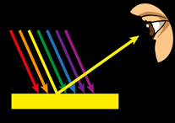
Science | Interdependence, Material Science and Series Circuits | Year 9 | Term 1
Science
Digestion, the Periodic Table and Forces
Year 7
Term 2
 | C1 – Acids and Alkalis | P1 – Properties of Light
B1 – Genetic Variation and Evolution
Key Vocabulary
double helix: two intertwined structures that form the spiral shape of DNA
gene: a short section of DNA that codes for a characteristic
allele: different versions of the same gene
mutation: a random change in the sequence of DNA bases
adaptation: a characteristic which increases an organism’s chance of survival and reproduction
evolution: the gradual change of a species over time
natural selection: the process by which individuals, who are better adapted to survive, increase their chance of reproducing
acid: a substance which has a pH < 7
base: a substance with a pH > 7 that reacts with an acid to form salt and water only
alkali: a water soluble substance with a pH > 7
neutralisation: the reaction between an acid and an alkali which results in a neutral pH = 7
pH scale: a scale ranging from 0 to 14 which determines how acidic or alkaline a substance is
indicator: a substance that changes colour when added to an acid or an alkali
transverse wave: oscillations are perpendicular to the direction of wave travel
medium: the substance which the wave is travelling through
reflection: the return of a wave from a surface
refraction: the change in direction of a wave passing from one medium to another with a different density
absorption: the transfer of energy of a wave to matter as the wave passes through
incident ray: the ray of light travelling towards the surface
reflected ray: the ray of light travelling away from the surface due to the process of reflection
B2 – Speciation and Biodiversity | C2 – Naming and Using Salts | P2 – Lenses and Filters
species: a group of organisms that can successfully interbreed to produce fertile offspring
speciation: the arise of a new species due to a population becoming isolated and natural selection occurring over a long period of time
biodiversity: the variety and variability of life on Earth or a particular region
extinction: when there are no more individuals left of a particular species
gene bank: a collection of genetic material from seeds, plants or animals that are preserved
Key Vocabulary
salt: the substance formed when the hydrogen ion in an acid is replaced by a metal ion
Key Vocabulary
convex lens: a piece of transparent material with curved sides to refract and focus light
convex: an outline or surface that curves outwards
prism: a 3D shape that has straight edges
white light: contains all the colours
acid + alkali —> salt + water
nitric + sodium → sodium + water Acid hydroxide nitrate
Acid Name | Salt Name
hydrochloric acid | metal chloride
phosphoric acid | metal phosphate
nitric acid | metal nitrate
sulfuric acid | metal sulfate
The object is yellow as the object absorbs all colours of the visible light spectrum except yellow light. This is then reflected into your eye therefore making the object appear yellow .
Notes:
https://www.bbc.co.uk/bitesize/guides/z9y64j6/revision/2

Slide 16
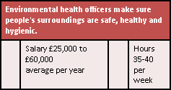
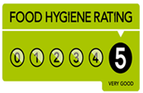
Technology | Food | Year 9 | Term 1
Science
Digestion, the Periodic Table and Forces
Year 7
Term 2
1: The Role of the Environmental Health Officer | 2: High Risk Foods | 3: Food Handlers
Inspecting business for food safety standards Follow up complaints Follow up outbreaks of food poisoning Collecting samples for testing Giving evidence in prosecutions Maintaining evidence Submitting reports Issue food hygiene rating | Foods high in protein and Foods high in moisture are described as high risk •Examples of high risk foods are :- •Eggs •Meat, poultry and other meat products •Milk and dairy products •Fish and Shellfish •Cooked rice •Stocks, sauces, gravies and soups •Foods which are handled and those which are reheated- •**However, preserved foods, or those with high concentrations of vinegar, salt or sugar, are low-risk | Have regular training in food safety •Be dressed in clean ‘whites’ or other uniform •Have hair tied back (and ideally wear a hat) •Have short, clean nails – no nail varnish or jewellery •Be in good health (no upset stomachs) •Have ‘good 'habits, e.g. no coughing or sneezing over food •Wash their hands after handling raw meat, after blowing nose, after going to the toilet etc •Cuts should be covered with a blue plaster
Notes:
https://www.bbc.co.uk/bitesize/guides/z9y64j6/revision/2

Slide 17
Weekly Wellbeing
Healthy Minds
Year 9
Term 1
1 – The Risks of Gang Culture
2 – Laws on Knives in the UK
Key Vocabulary gang: an organized group of criminals
A gang is different to a social group of friends. Gangs are linked to unsocial behaviour and organised crime.
Gangs can sometimes look like an appealing option to young people, especially the social side of being with people of a similar age on a regular basis.
There are many long term issues linked to being part of a gang. These include:
Poor exam grades linked to poor attendance at school
Criminal records which stay with you forever
Lack of friends outside of the gang
Poor reputation in the local community
Key Vocabulary knife crime: criminal offences committed using a knife as a weapon
It is against the law to use any knife in a threatening way.
It is illegal to carry a knife in public without good reason.
Any adult charged with carrying a knife will automatically go to court.
Anyone aged between 10-17 will be referred to the Youth Offending Team.
Many young people who carry knives have been asked to by other people (maybe in gangs or criminal groups). This is still against the law – even if you have been told to do it.
Carrying a knife as a form of defence is still against the law. Most people who are hurt by knives are often carrying a knife themselves.
3 – Laws on Drugs in the UK
4 – Risks of Drug Addiction
Key Vocabulary drugs: a medicine or other substance which has a physiological effect when ingested or otherwise introduced into the body
Illegal drugs in the UK are divided into 3 categories:
Class A drugs are classed as the most dangerous and carry the more severe sanctions. These drugs include cocaine, ecstasy, heron.
Class B drugs include ketamine and cannabis.
Class C drugs include anabolic steroids and khat.
You can be charged with a crime if you are found with drugs in your possession, regardless of whether you intended to use them or not.
Key Vocabulary addiction: the fact or condition of being addicted to a particular substance or activity
There are physical and mental side effects if you have experienced drug addiction.
Long term physical side effects can include: liver failure, kidney damage, increased blood pressure.
Long term mental side effects can include: depression, anxiety, paranoia,
People who have experienced drug addiction may also struggle to find and keep a job, which might result in a lack of income.
There are many sources of support for people with drug addiction. Your GP (doctor) is the best place to start.
Notes:
https://www.bbc.co.uk/bitesize/guides/z9y64j6/revision/2

Slide 18
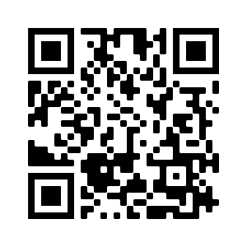
Drama
Pantomime
Year 7
Term 2
Revision Strategies | Term 1
Look
Look at the information carefully.
Read it three times.
It may help to say it as you read it.
Flash Cards
If you choose to make flashcards to help you revise, don’t forget our top tips.
On one side of the card, write the question clearly
On the other side of the card, write the answer you want to remember
Only put one question on each flashcard
Test yourself regularly, until you can't get the answers wrong
Cover
Cover it with your hand or a piece of paper.
Write
Write it out, from memory.
Check what you have written matches the information exactly.
Have you got it correct?
If so, tick your work to show it is correct.
Check
If it doesn’t match exactly, use your purple pen to correct it.
Repeat the steps above.
If you get 100% correct, move on to the next piece of information.
Correct
Scan the QR code to access a short video on how to use your flashcards more effectively.
Notes:
https://www.bbc.co.uk/bitesize/guides/z9y64j6/revision/2

